Slide 1
Milestones 1 & 2 - Analysis
Machine Learning (MAC-LRN)
Arevalo, Mark Anthony
Nablo, Juan Paolo
Vivo, Roi Emmanuel

Slide 2
Dataset
Spambase - Spam Mail Detection
Diabetic Retinopathy

Slide 3
Machine Learning Techniques
Milestone 1
Complete Feature Set, Forward Search, Backward Elimination, PCA.
kNN (k = 1, 3, 5, 7 ,9)
Decision Trees
Bayesian Network
Milestone 2
k-Means Clustering
SOM

Slide 4
Milestone 1

Slide 5
Milestone 1: Spambase
Dataset Building and Normalization
Source of Dataset: UCI Machine Learning Repository
Description of Dataset (include the number of original features and the sample size):
This dataset contains a collection of spam emails from a set of individuals who have filed spam to the owner’s postmaster. Within the dataset, there exists a collection of non-spam emails as well. There are 4601 samples and 58 features.

Slide 6
Milestone 1: Spambase
3. Name, Description and type of each feature. Include here if you had to normalize the feature, the reason for its normalization and the range of values (e.g. 0 to 1).
48 continuous real [0,100] attributes of type word_freq_WORD
= percentage of words in the e-mail that match WORD, i.e. 100 * (number of times the WORD appears in the e-mail) / total number of words in e-mail. A "word" in this case is any string of alphanumeric characters bounded by non-alphanumeric characters or end-of-string.
6 continuous real [0,100] attributes of type char_freq_CHAR
= percentage of characters in the e-mail that match CHAR, i.e. 100 * (number of CHAR occurences) / total characters in e-mail

Slide 7
Milestone 1: Spambase
1 continuous real [1,...] attribute of type capital_run_length_average
= average length of uninterrupted sequences of capital letters
1 continuous integer [1,...] attribute of type capital_run_length_longest
= length of longest uninterrupted sequence of capital letters
1 continuous integer [1,...] attribute of type capital_run_length_total
= sum of length of uninterrupted sequences of capital letters
= total number of capital letters in the e-mail
1 nominal {0,1} class attribute of type spam
= denotes whether the e-mail was considered spam (1) or not (0), i.e. unsolicited commercial e-mail.

Slide 8
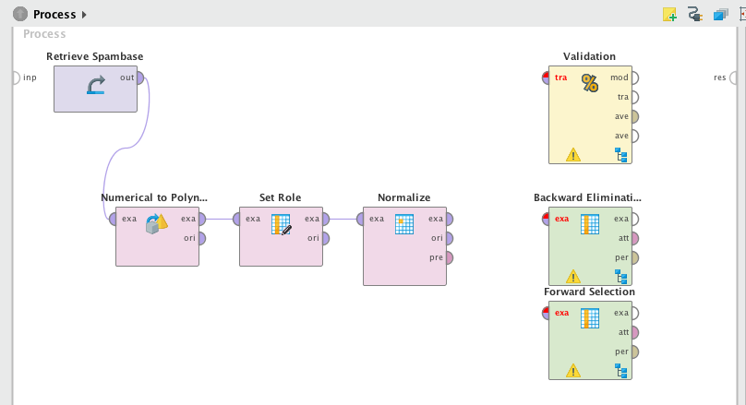

Slide 9
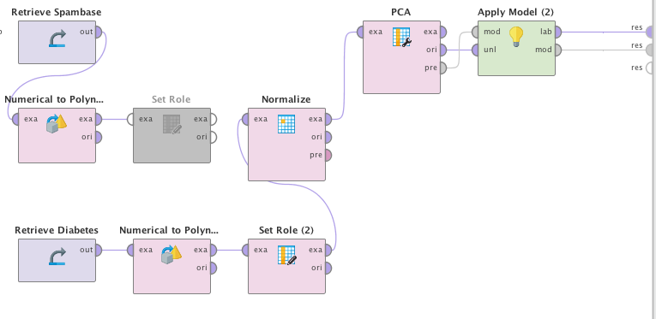

Slide 10
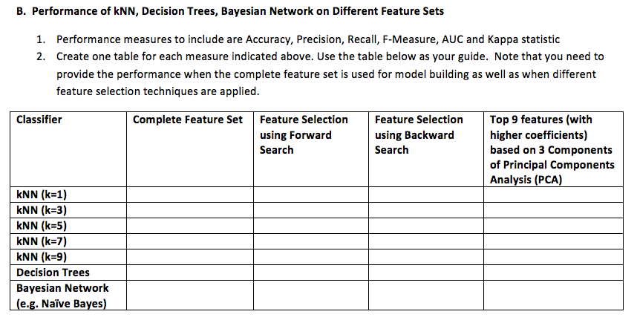

Slide 11
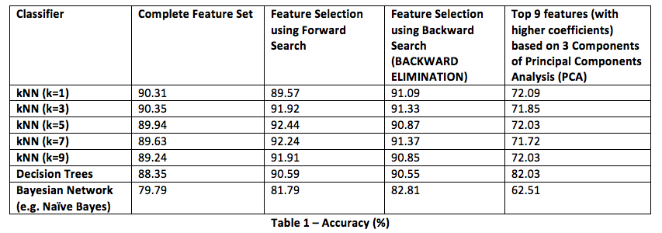

Slide 12
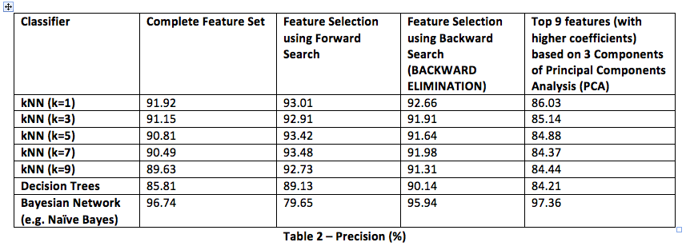

Slide 13
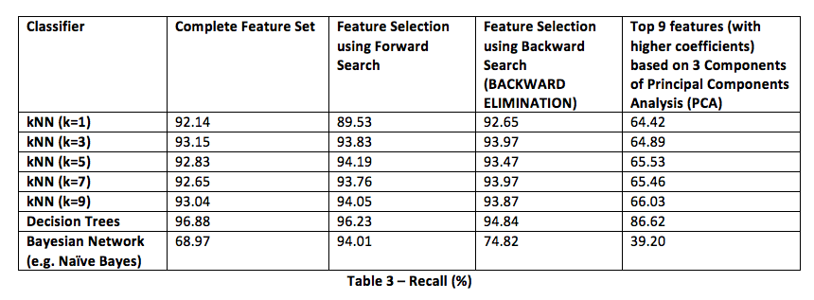

Slide 14
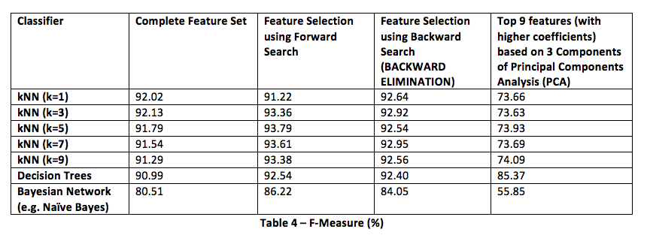

Slide 15
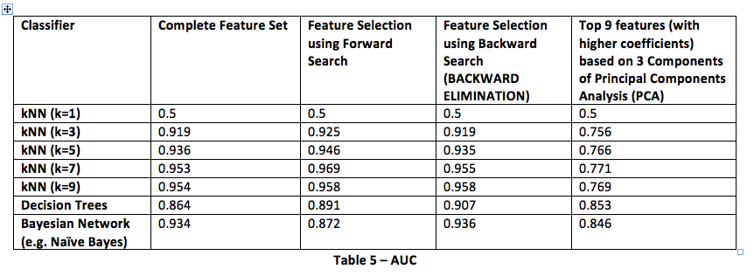

Slide 16
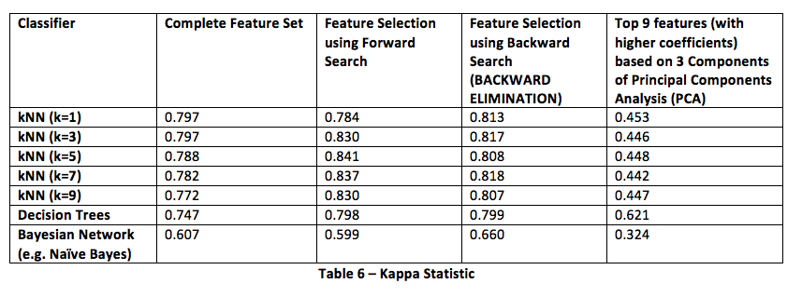

Slide 17
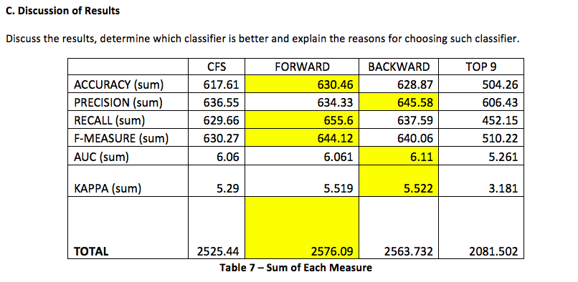
C. Discussion of Results
The sum of each measure of Complete Feature Set (CFS), Feature Selection using Forward search and Backward Elimination, and Principal Components Analysis (PCA) have been recorded onto table 7.

Slide 18
C. Discussion of Results
Based on the results above, the Feature Selection using Forward Search is more dominant compared to the others. Though Forward Search and Backward Search have close values, Forward Search has a slightly bigger Total compared to Backward Search. Since Forward Search is more prevalent in Table 7, Forward Search has been chosen to be the classifier.

Slide 19
Milestone 1: Diabetic Retinopathy
Dataset Building and Normalization
Source of Dataset:
UCI Machine Learning Repository – Center for Machine Learning and Intelligent Systems http://archive.ics.uci.edu/ml/datasets/Diabetic+Retinopathy+Debrecen+Data+Set
Dr. Balint Antal, Department of Computer Graphics and Image Processing Faculty of Informatics, University of Debrecen, 4010, Debrecen, POB 12, Hungary antal.balint '@' inf.unideb.hu
Dr. Andras Hajdu, Department of Computer Graphics and Image Processing Faculty of Informatics, University of Debrecen, 4010, Debrecen, POB 12, Hungary hajdu.andras '@' inf.unideb.hu

Slide 20
Milestone 1: Diabetic Retinopathy
Description of Dataset:
Number of original features - 20
Sample size - 1151
This dataset contains features extracted from the Messidor image set to predict whether an image contains signs of diabetic retinopathy or not. All features represent either a detected lesion, a descriptive feature of a anatomical part or an image-level descriptor. The underlying method image analysis and feature extraction as well as our classification technique is described in Balint Antal, Andras Hajdu: An ensemble-based system for automatic screening of diabetic retinopathy, Knowledge Based Systems 60 (April 2014), 20-27.

Slide 21
Milestone 1: Diabetic Retinopathy
Name, Description, and Type of each feature:
A - Result of Quality Assessment
Continuous Real = [0 - 1]
B - Result of Pre-screening
Continuous Real = [0 - 1]
C-H - Results of MA detection
Continuous Real = [0 - 1]
I-P - Results of MA detection for exudates
Continuous Real = [0 - 1]
Q - Euclidean distance of the center of the macula and the center of the optic disc
Continuous Real = [0 - 1]
R - The diameter of the optic disc
Continuous Real = [0 - 1]
S - The binary result of the AM/FM-based classification
Continuous Real = [0 - 1]
T - Class
Binomial ⊆ [false, true]
The attributes were set from Numerical to Binomial, from Nominal to Numerical, and then normalized to attain a linear and more robust relationship.

Slide 22
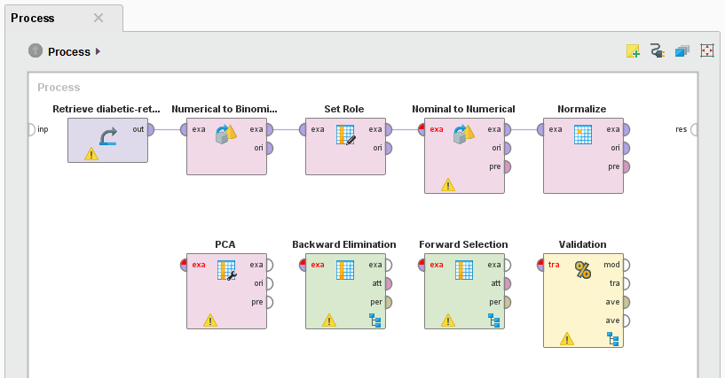

Slide 23
B. Performance of kNN, Decision Trees, Bayesian Network on Different Feature Sets
Classifier | Complete Feature Set | Feature Selection using Forward Search | Feature Selection using Backward Search | Top 9 features (with higher coefficients) based on 3 Components of Principal Components Analysis (PCA)
kNN (k=1) | 61.25 % | 68.20 % | 63.34 % | 67.16 %
kNN (k=3) | 62.29 % | 71.42 % | 64.47 % | 64.64 %
kNN (k=5) | 63.16 % | 72.20 % | 66.20 % | 65.68 %
kNN (k=7) | 64.73 % | 70.89 % | 68.03 % | 67.33 %
kNN (k=9) | 63.94 % | 70.89 % | 65.94 % | 68.20 %
Decision Trees | 53.69 % | 54.39 % | 54.39 % | 53.26 %
Bayesian Network (e.g. Naïve Bayes) | 60.30 % | 65.68 % | 65.07 % | 59.77 %
Table 1 – Accuracy
Classifier | Complete Feature Set | Feature Selection using Forward Search | Feature Selection using Backward Search | Top 9 features (with higher coefficients) based on 3 Components of Principal Components Analysis (PCA)
kNN (k=1) | 0.225 | 0.365 | 0.267 | 0.341
kNN (k=3) | 0.247 | 0.429 | 0.291 | 0.292
kNN (k=5) | 0.265 | 0.446 | 0.326 | 0.315
kNN (k=7) | 0.296 | 0.420 | 0.362 | 0.348
kNN (k=9) | 0.281 | 0.422 | 0.321 | 0.366
Decision Trees | 0.069 | 0.030 | 0.093 | 0.017
Bayesian Network (e.g. Naïve Bayes) | 0.233 | 0.322 | 0.313 | 0.201
Table 2 – Kappa

Slide 24
B. Performance of kNN, Decision Trees, Bayesian Network on Different Feature Sets
Classifier | Complete Feature Set | Feature Selection using Forward Search | Feature Selection using Backward Search | Top 9 features (with higher coefficients) based on 3 Components of Principal Components Analysis (PCA)
kNN (k=1) | 0.500 | 0.500 | 0.500 | 0.300
kNN (k=3) | 0.660 | 0.736 | 0.675 | 0.684
kNN (k=5) | 0.680 | 0.771 | 0.703 | 0.713
kNN (k=7) | 0.694 | 0.761 | 0.717 | 0.725
kNN (k=9) | 0.696 | 0.767 | 0.708 | 0.731
Decision Trees | 0.549 | 0.548 | 0.565 | 0.529
Bayesian Network (e.g. Naïve Bayes) | 0.689 | 0.678 | 0.700 | 0.652
Table 3 – AUC
Classifier | Complete Feature Set | Feature Selection using Forward Search | Feature Selection using Backward Search | Top 9 features (with higher coefficients) based on 3 Components of Principal Components Analysis (PCA)
kNN (k=1) | 64.40 % | 71.60 % | 66.67 % | 69.19 %
kNN (k=3) | 65.83 % | 75.09 % | 68.23 % | 67.59 %
kNN (k=5) | 66.91 % | 76.89 % | 70.48 % | 69.22 %
kNN (k=7) | 68.60 % | 75.75 % | 71.97 % | 71.10 %
kNN (k=9) | 67.88 % | 76.85 % | 70.02 % | 72.15 %
Decision Trees | 56.27 % | 53.80 % | 58.24 % | 53.54 %
Bayesian Network (e.g. Naïve Bayes) | 81.56 % | 73.28 % | 74.59 % | 64.45 %
Table 4 – Precision

Slide 25
B. Performance of kNN, Decision Trees, Bayesian Network on Different Feature Sets
Classifier | Complete Feature Set | Feature Selection using Forward Search | Feature Selection using Backward Search | Top 9 features (with higher coefficients) based on 3 Components of Principal Components Analysis (PCA)
kNN (k=1) | 60.39 % | 66.45 % | 61.87 % | 68.74 %
kNN (k=3) | 60.23 % | 69.07 % | 61.87 % | 64.16 %
kNN (k=5) | 60.56 % | 68.09 % | 62.52 % | 63.67 %
kNN (k=7) | 61.87 % | 66.45 % | 65.14 % | 64.81 %
kNN (k=9) | 60.88 % | 64.65 % | 62.68 % | 65.20 %
Decision Trees | 57.28 % | 99.67 % | 49.75 % | 90.34 %
Bayesian Network (e.g. Naïve Bayes) | 32.57 % | 55.65 % | 51.88 % | 54.01 %
Table 5 – Recall
Classifier | Complete Feature Set | Feature Selection using Forward Search | Feature Selection using Backward Search | Top 9 features (with higher coefficients) based on 3 Components of Principal Components Analysis (PCA)
kNN (k=1) | 62.33 % | 68.93 % | 64.18 % | 68.97 %
kNN (k=3) | 62.91 % | 71.95 % | 64.89 % | 65.83 %
kNN (k=5) | 63.57 % | 72.22 % | 66.26 % | 66.33 %
kNN (k=7) | 65.06 % | 70.79 % | 68.38 % | 67.81 %
kNN (k=9) | 64.19 % | 70.22 % | 66.15 % | 68.56 %
Decision Trees | 56.77 % | 69.88 % | 53.66 % | 67.23 %
Bayesian Network (e.g. Naïve Bayes) | 46.55 % | 63.26 % | 61.20 % | 58.77 %
Table 6 – F-Measure

Slide 26
C. Discussion Of Results
Based on the results, the following characteristics were observed:
In the Complete Feature Set, kNN (k=7) was the best classifier.
In the Feature Selection Forward Search, kNN (k=5) was the best classifier.
In the Feature Selection Backward Search, kNN (k=7) was the best classifier.
In PCA, kNN (k=9) was the best classifier.
This shows that overall, kNN (k=7) was the best classifier.

Slide 27
Milestone 2

Slide 28
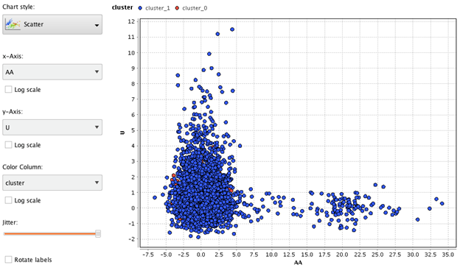
k-Means Clustering: Spambase
From different tested clusters, k = 20 shows different clustered data
When k = 2

Slide 29
k-Means Clustering: Spambase
Cluster | Number of samples
0 | 244
1 | 4357
Total | 4601

Slide 30
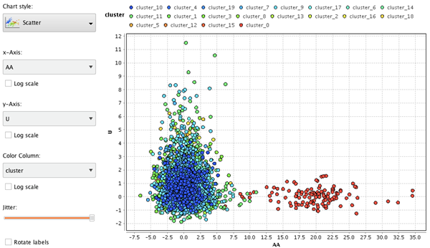
k-Means Clustering: Spambase
When k = 20

Slide 31
k-Means Clustering: Spambase
Cluster | Number of samples | Cluster | Number of samples | Cluster | Number of samples
0 | 128 | 8 | 99 | 16 | 60
1 | 193 | 9 | 746 | 17 | 511
2 | 47 | 10 | 245 | 18 | 40
3 | 620 | 11 | 923 | 19 | 37
4 | 107 | 12 | 46
5 | 70 | 13 | 189
6 | 71 | 14 | 130
7 | 334 | 15 | 5

Slide 32
k-Means Clustering: Spambase
Cluster 20 was chosen because all clusters from 2 to 19 produced similar results
Solution may become better if k > 20
Data were more similar than dissimilar
Because of this issue, classes are difficult to distinguish

Slide 33
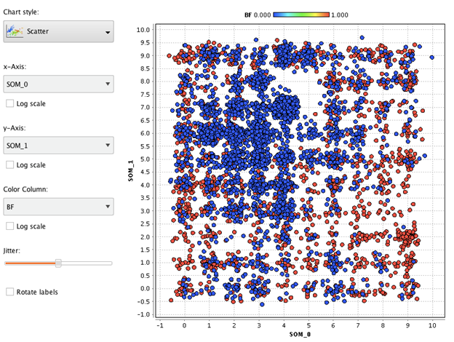
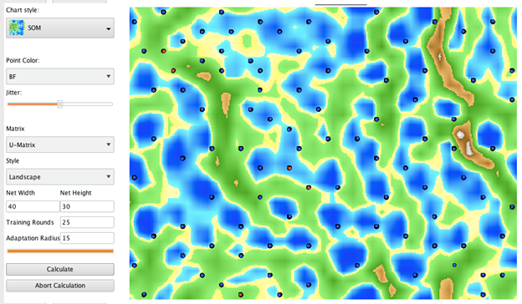
SOM: Spambase
Scatter Plot & SOM - 1,000 Training Rounds

Slide 34
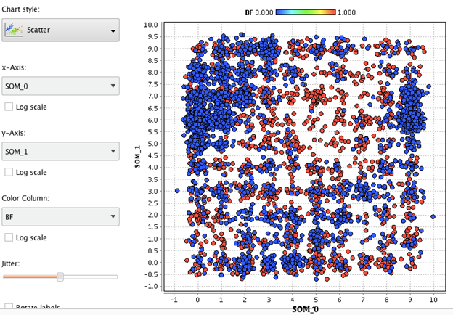
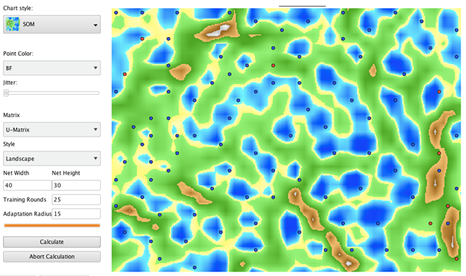
SOM: Spambase
Scatter Plot & SOM - 10,000 Training Rounds

Slide 35
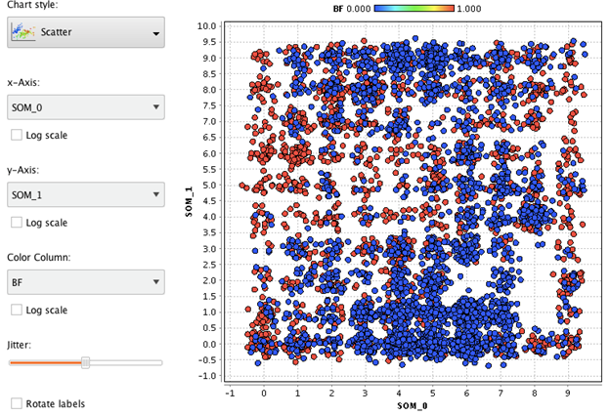
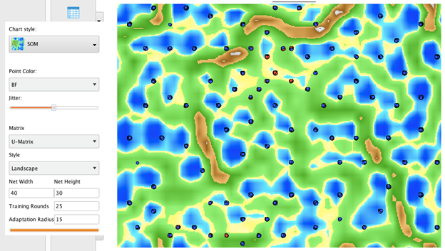
SOM: Spambase
Scatter Plot & SOM - 15,000 Training Rounds

Slide 36
SOM: Spambase
Based on all the maps, it is difficult to distinguish what kind of samples are assigned to the parts of the map especially with no labels on it.
Just like the clustering process, the maps are unorganized though the map with 1000 training rounds is more “clean” compared to the others.

Slide 37
SOM: Spambase
Even with unsupervised learning, the dataset was still unorganized due to similarities of the data in the features. The data can still be used for analysis, but it will not be as accurate for predictions.

Slide 38
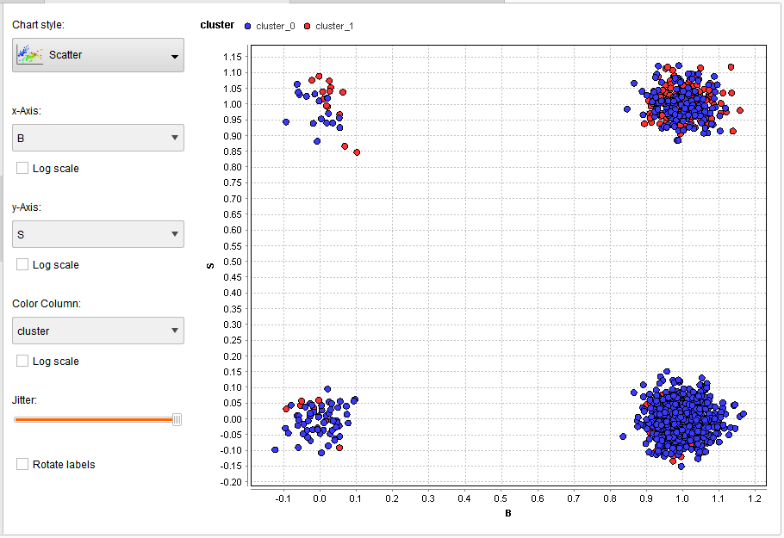
K-means Clustering: Diabetic Retinopathy
Since the features B and S was found out to be the top features based on PCA, it can be observed that at K = 2, x-axis = B, and y-axis = S, the two clusters merge with each other.

Slide 39
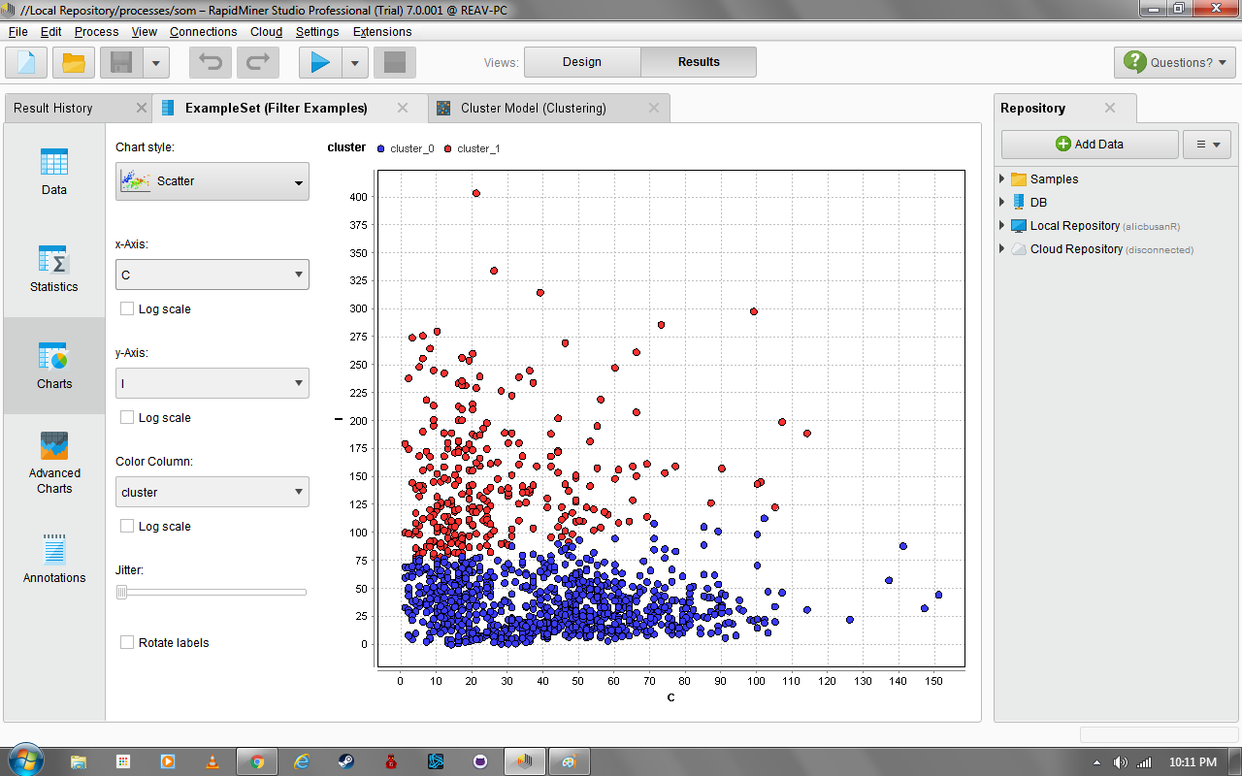
k-Means Clustering: Diabetic Retinopathy
From different tested clusters, k = 2 shows different clustered data

Slide 40
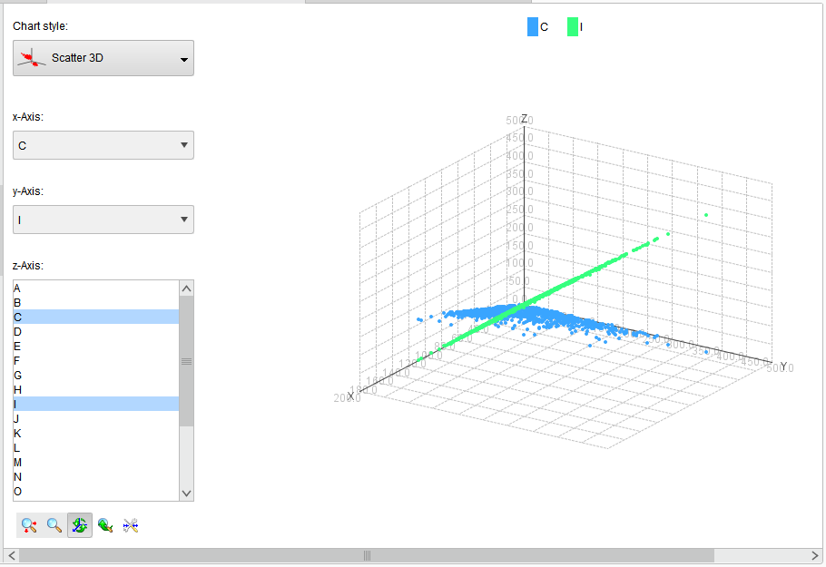
K-means Clustering: Diabetic Retinopathy
The solution to this is that the clusters where displayed in a higher-dimension plot to fully separate each clusters.

Slide 41
k-Means Clustering: Diabetic Retinopathy
Cluster | Number of samples
0 | 292
1 | 859

Slide 42
k-Means Clustering: Diabetic Retinopathy
Cluster 2 was chosen because both clusters were distinguishable from one another
Both clustered data may be separated, however, the centroids of these two are similar that at some point, samples cannot be differentiated from one another

Slide 43
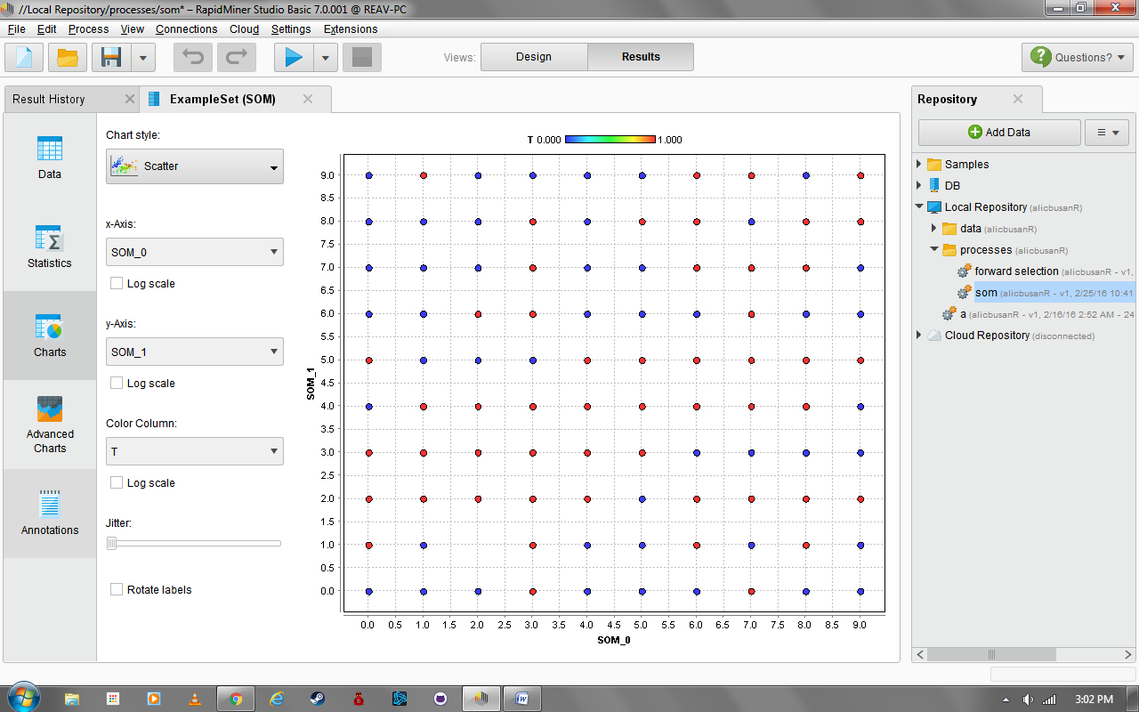
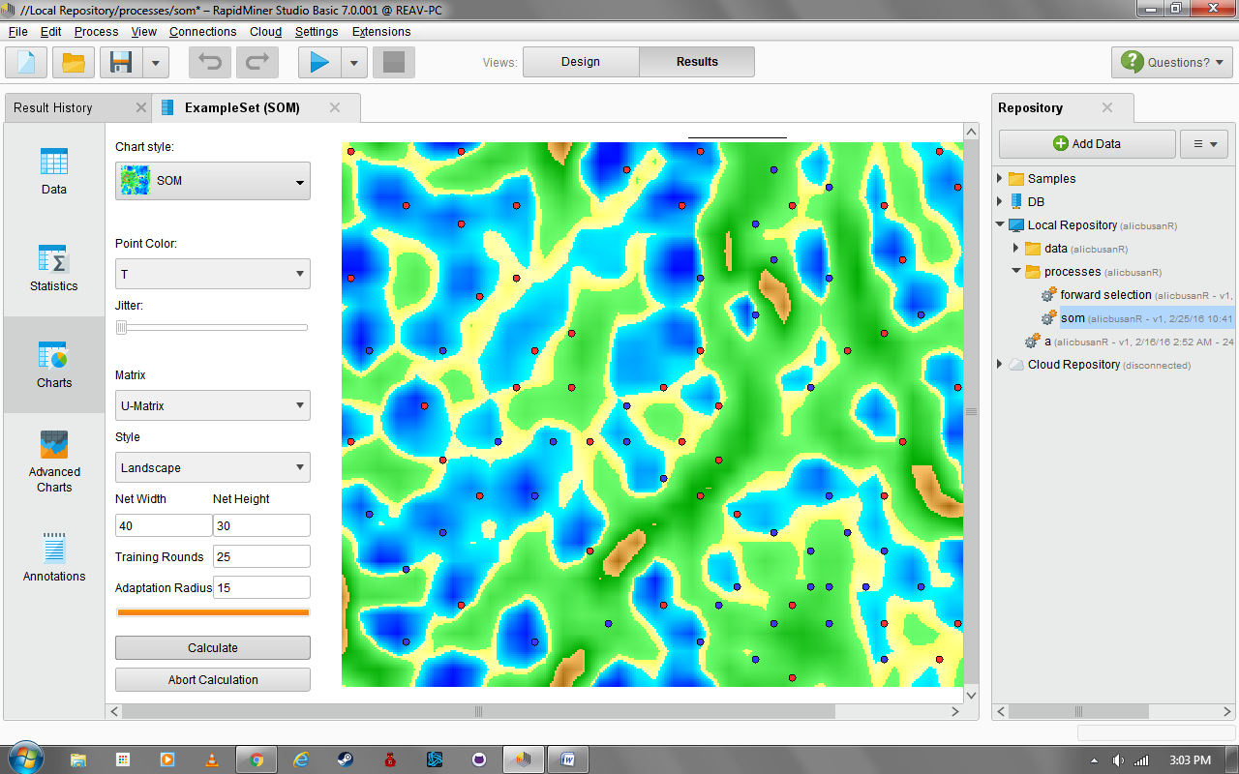
SOM: Diabetic Retinopathy
Scatter Plot and SOM:
1,000 Training Rounds

Slide 44
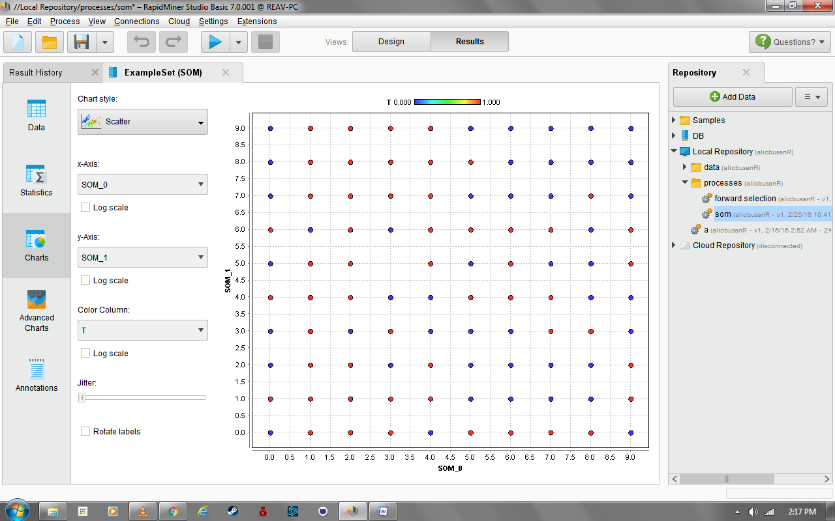
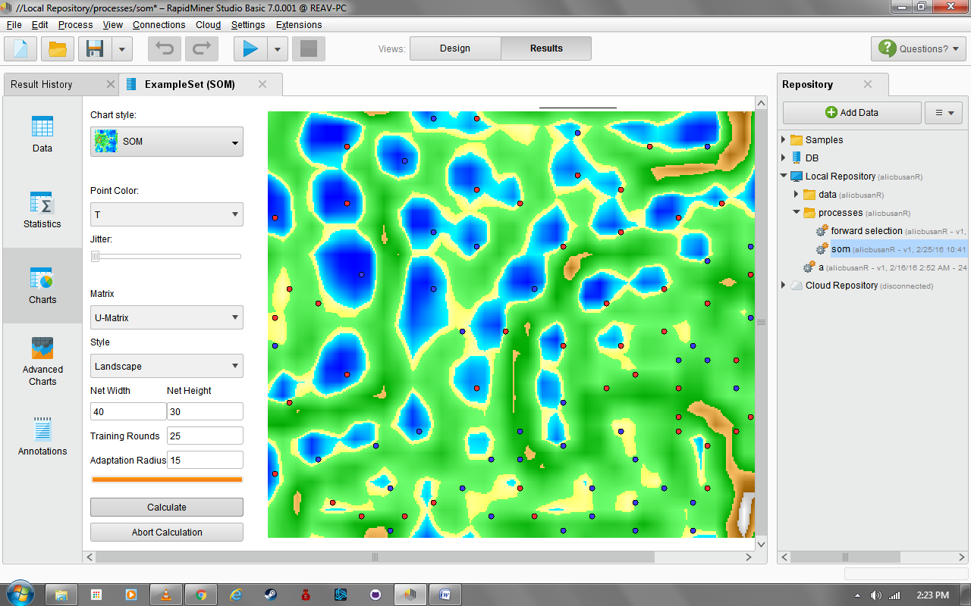
SOM: Diabetic Retinopathy
Scatter Plot and SOM-
10,000 Training Rounds

Slide 45
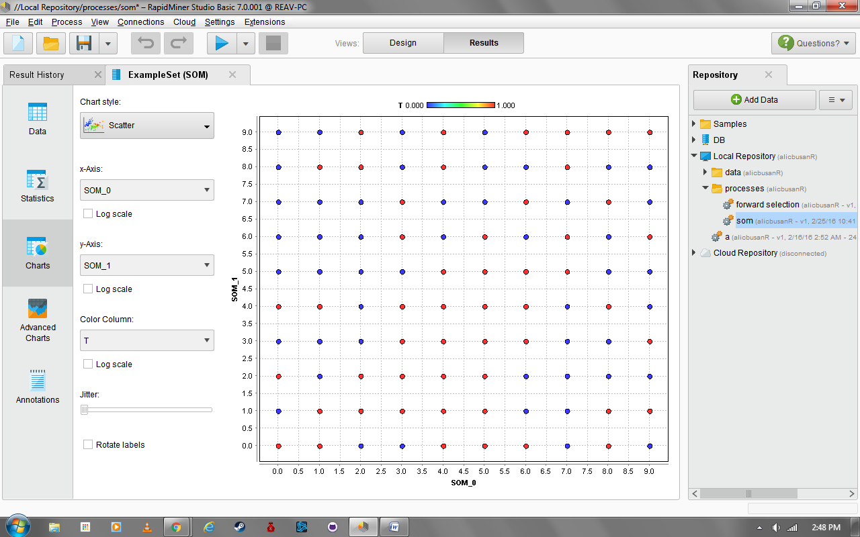
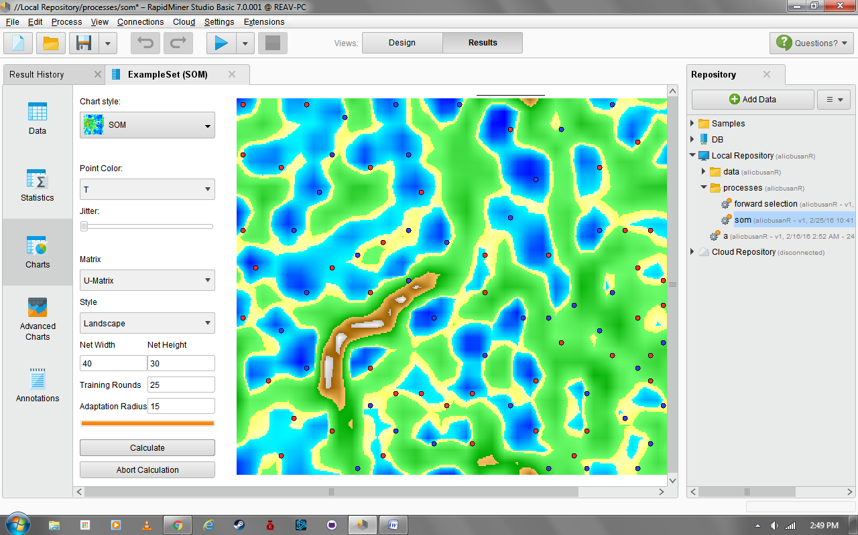
SOM: Diabetic Retinopathy
Scatter Plot and SOM –
15,000 Training Rounds

Slide 46
Discussion Of Results
All of the information here were taken at jitter set to a minimum producing a 10x10 SOM map with clear, specific, and distinct nodes that allows the classification of each sample more precise and accurate.
Although the actual relationship between each node were not discussed, this still shows a limited display of the SOM of diabetes.

